Slide 1
Power accountants association annual meeting 2019
Presented by matt wood, cpa
Partner – ata (alexander Thompson Arnold)

Slide 2
What do we want to learn?
How can I best segregate/separate duties with limited personnel?
Discussing Risk Assessment and therefore how to best Manage Risks
Current Fraud Trends

Slide 3
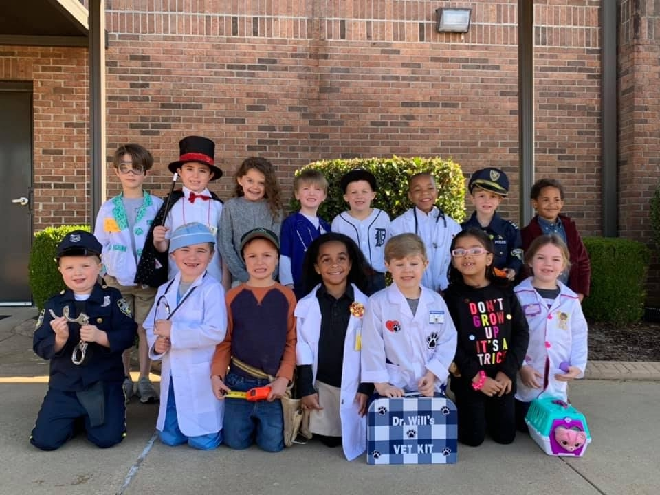
What do we want to learn?

Slide 4
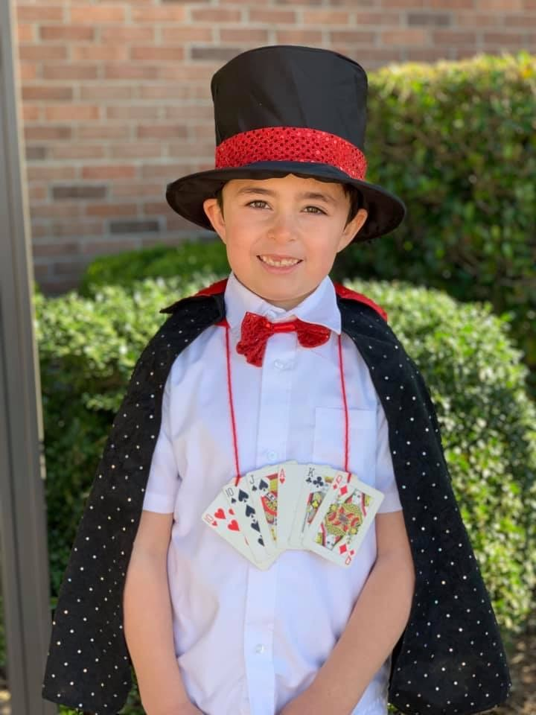
What do we want to learn?

Slide 5
Fraud risk assessment
Systematically identify where and how fraud may occur
Identify who may be in a position to commit fraud
Creates a structured process that identifies fraud risk schemes and respective controls that may prevent or detect these schemes
Measures detective and preventative controls to ensure they are designed and operating effectively
Strengthens an organization’s ability to evaluate, mitigate and monitor risks arising from fraud, corruption and misconduct.

Slide 6
Fraud risk assessment
Considers both internal and external threats
Tailored to your organization and industry
It is an ONGOING CONTINUOUS process that never ends

Slide 7
Organization’s governance structure
A written policy (or policies) should be in place to convey the expectations of the board of directors and senior management regarding managing fraud risk.
Fraud risk exposure should be assessed periodically by the organization to identify specific potential schemes and events that the organization needs to mitigate.
Prevention techniques to avoid potential key fraud risk events should be established, where feasible, to mitigate possible impacts on the organization.
Detection techniques should be established to uncover fraud events when preventive measures fail or unmitigated risks are realized.

Slide 8
Organization’s governance structure
Every organization should have a reporting process in place to solicit input on potential fraud and that it is addressed timely.

Slide 9
Fraud triangle
Opportunity – Can I execute without being caught? Access to sensitive information (Controls)
Rationalization – Personal justification of dishonest actions; Sense of revenge towards the organization or co-workers; Everybody else is doing it and nobody gets caught (Values)
Pressure/Motivation – Financial or emotional force pushing us; Financial need; Addictions such as gambling; Pressure of non-performance (Culture)

Slide 10
Fraud PREVENTION triangle
PREVENT – Stop It
DETER – Slow It Down
DETECT – Catch It

Slide 11
What are some common themes in accounting frauds?
In the For Profit World, I would note a few easy ones:
  Pressure to Perform – Investors/Wall Street
  Tone at the Top – Boss doesn’t care; Arrogance/Greed
  Lack of appropriate controls – CFOs and CEOs monopolize the end numbers
  External Auditors not exhibiting professional skepticism and due care –
    Bank of America Audit Fee in 2014?
    Enron (6th largest company in the world) paid $25 Million in Audit Fees and $27 Million in Consulting/Tax Fees making them one of Arthur Anderson’s biggest clients.

Slide 12
What are some common themes in accounting frauds?
In the Utility World, I can note a few as well:
  Pressure to keep friends happy – Contracts
  Tone at the Top – Free Vacation Time/Credit Card Expenses
  Lack of appropriate controls – It’s faster if I do it this way; Faster usually doesn’t happen without circumvention of controls; Beware of the “I’ll Do That For You” people.

Slide 13
Why conduct a fraud risk assessment?
A Fraud Risk Assessment helps Management understand risks that are unique to is business activities, identify gaps, weaknesses in controls and priorities of controls to manage those risks and develop a realistic plan for targeting the right resources and controls to reduce fraud risks.
Start by Asking Yourself – If I were to really need money, how could I steal from my company?

Slide 14
Why conduct a fraud risk assessment?
Improve communication and awareness about fraud
Identify where the Utility/Company is most vulnerable to fraud and what activities put it at the Greatest Risk
Develop plans to mitigate fraud risk
Develop techniques to monitor and investigate high-risk areas
Assess internal controls

Slide 15
Why conduct a fraud risk assessment?
If you are a Utility in the State of TN and fall under the Comptroller’s Office, you are required to perform a fraud risk assessment.
The State requires a COSO Internal Control Document and COSO 2013 – Principal 8 says “The organization considers the potential for fraud in assessing risks to the achievement of objectives.”

Slide 16
Benefits of a fraud risk assessment
Prevent, deter and detect fraud
Prevent financial losses
Prevent potential damage to reputation
Best Practice

Slide 17
How can it fail?
“No Fraud Here” Mentality
“They would never.” Using your faith in people as a control.
Assessment is not risk-based
Skill sets are not available to perform assessment correctly
Not systematic and reoccurring

Slide 18
What’s a fraudster look like?
Family Business Fraud - AR
More Than the Boss - Payroll
Motorcycle Shop or Electric System – Inventory

Slide 19
How much you want to spend?
If a Salesman knows how much you want to spend, do you think they can find something you can afford?
Same goes for Fraud Prevention!
There is a Cost/Benefit to Fraud Prevention that definitely needs to be taken into account. If I know what you are wanting to protect/prevent from being stolen, I can create a way to “almost” prevent it from happening. However, the cost may be more than the item you are protecting.

Slide 20
How do I separate duties with limited personnel?
Try and Show How to Separate with TWO employees, so anyone that has more than TWO employees should be able to separate even more.
Let’s start with an Exercise: Grab a Piece of Paper and Sign Your Name

Slide 21
Receipt process
 | Open Mail and Stamp “For Deposit Only” | Cash Drawer | Stamp & Issue Receipts for OTC Checks | Daily Deposit Makeup or Check
Employee One | X |  |  | X
Employee Two |  | X | X

Slide 22
Non-Payroll disbursements
 | Write Checks | Verify Amount, Sign and Mail Checks | Maintain Custody of Signature (if Electronic or a Plate) | Post Checks to Accounting Records
Employee One | X |  |  | X
Employee Two |  | X | X

Slide 23
Payroll disbursements
 | Obtaining Time Sheets & Approve them | Write Checks | Approve Amounts (Payroll Journal), Sign and Deliver Payroll Checks | Maintain Custody of Signature (if Electronic or Plate) | Review Final Payroll Ledger for Reasonableness (Either/Both)
Employee One | X | X |  |  | X
Employee Two |  |  | X | X | X

Slide 24
BANK RECONCILIATIONS
 | Receive, Open, and Review Bank Statements and Cancelled Checks | Perform the Reconciliation | Review the Bank Reconciliation and Trace Relevant Items to Accounting Records | Prepare any necessary Adjusting Journal Entries
Employee One | X |  | X
Employee Two |  | X |  | X

Slide 25
AR RECONCILIATIONS/BILLINGS
 | Ability to Write-off Accounts Receivable | Performing the AR Reconciliation | Review of AR Reconciliation | Preparing the Necessary Journal Entries
Employee One | X |  | X
Employee Two |  | X |  | X

